Slide 1


DATA ANALYSIS ON
AMAZON SALES DATA

Slide 2
CONTENT :
ABOUT DATASET
PRODUCT ANALYSIS
SALES ANALYSIS
CUSTOMER ANALYSIS
DATA WRANGLING
FEATURE ENGINEERING
BUSINESS QUESTIONS

Slide 3
1. ABOUT DATASET
The dataset we have is Amazon sales.
This project aims to gain insight into the sales data of Amazon to understand different factors that affect sales of different branches.
It contains 1000 rows and 17 columns.
This dataset contains sales transactions from three different branches of Amazon located in Mandalay, Yangon and Naypyitaw.

Slide 4
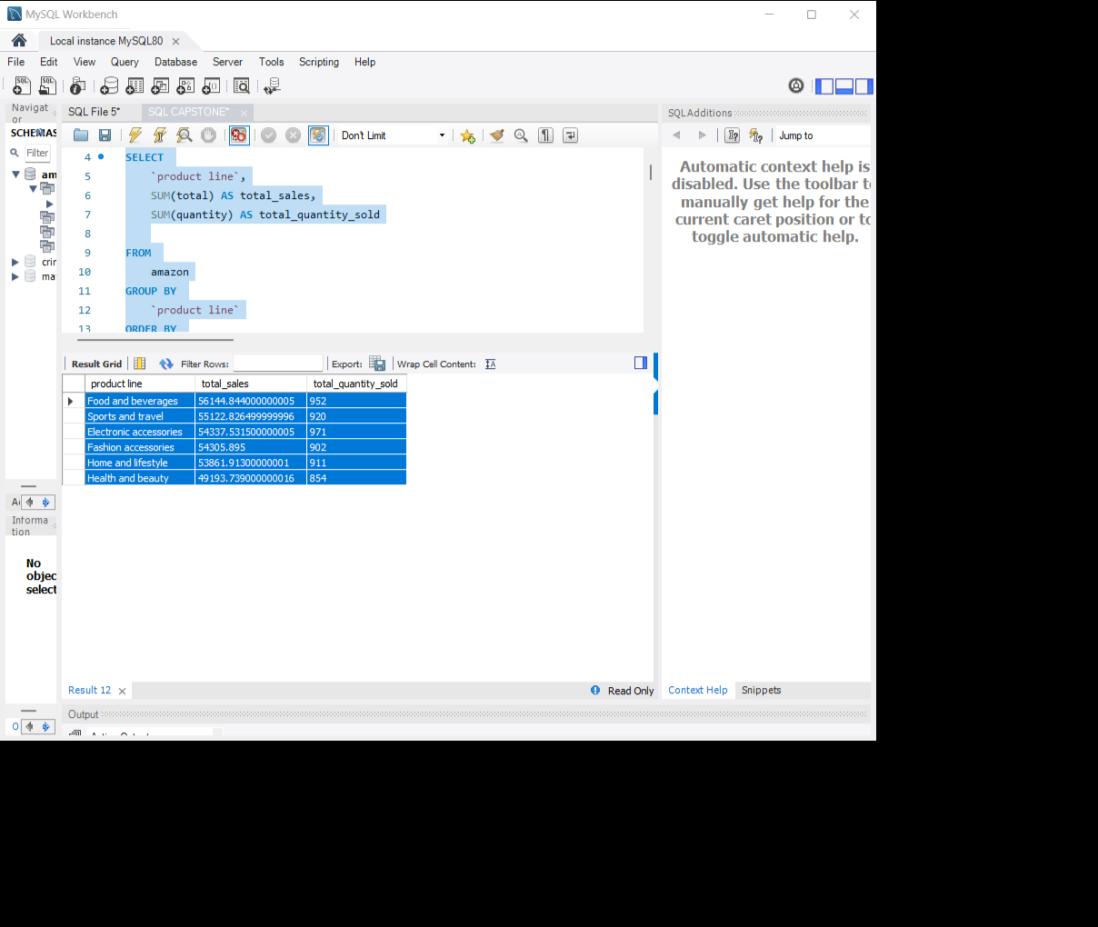
2. PRODUCT ANALYSIS
Dataset contains 6 different product lines
Product lines performing best and need to be improved
Food and beverages
Sports and travel
Electronic accessories
Fashion accessories
Home and lifestyle
Health and beauty

Slide 5
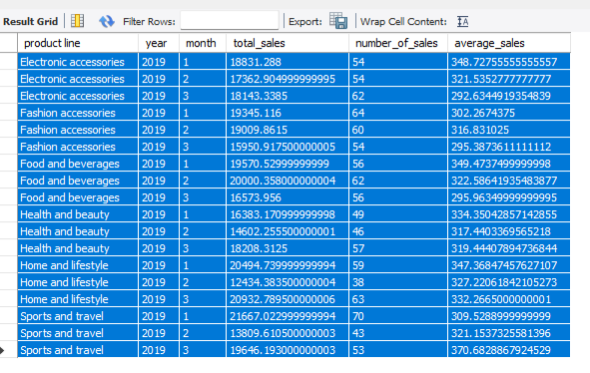
3. SALES ANALYSIS
The total sales, number of sales and average sales over time for each product line will help us understand the sales trend for each product line
MONTH | PRODUCT
January | Electronic accessories Sports and travels Fashion accessories
February | Food and beverages
March | Health and beauty Home and lifestyle

Slide 6
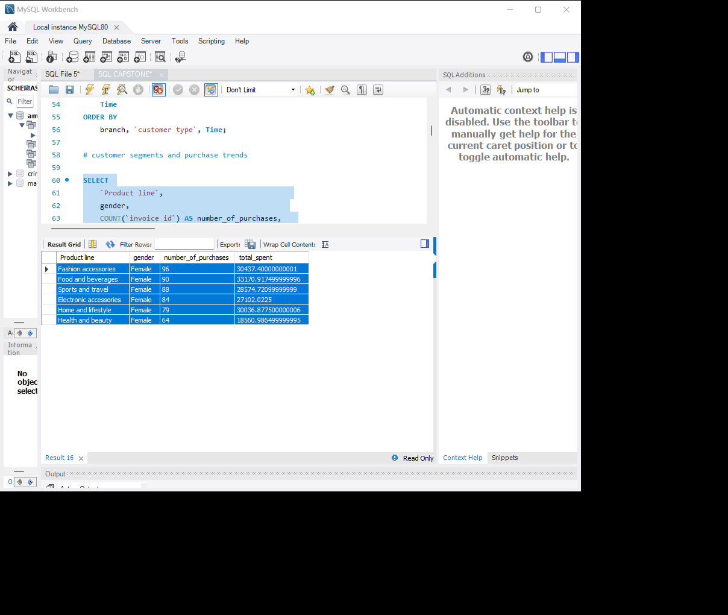

4. CUSTOMER ANALYSIS
Customer trends and purchase trends
FEMALE CUSTOMERS
MALE CUSTOMERS

Slide 7
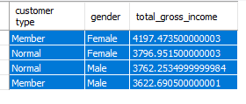
Profitability of each customer segment

Slide 8
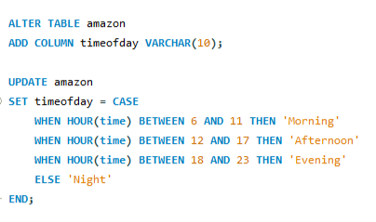
5. DATA WRANGLING
This is the step where null values and missing values are detected and these are replaced using data replacement methods.
There were no missing or null values found in the dataset
6. FEATURE ENGINEERING
Adding time of day column :
This column will categorize the transactions into
‘Morning’, ‘Afternoon’ and ‘Evening’ based on the
time given in the dataset

Slide 9

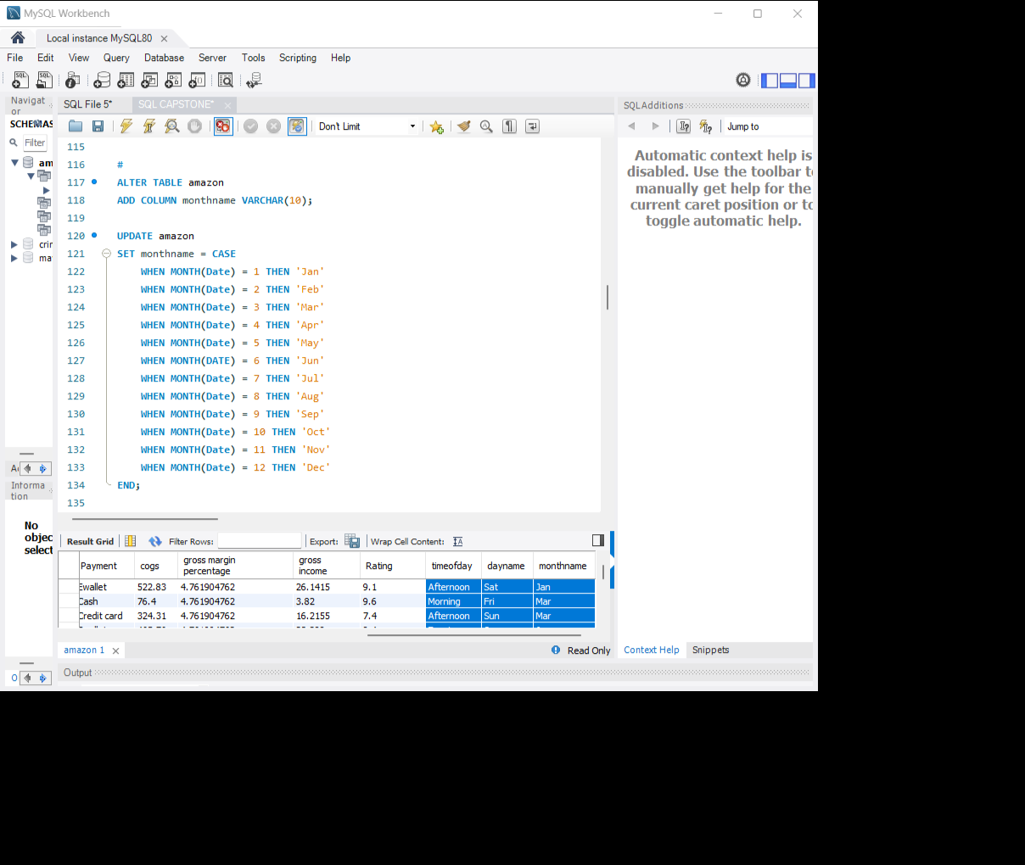
Adding Day name column :
This column will store the name of the day of the week on
which each transaction occurred based on the date column.
Adding Month name column :
This column will store the name of the month during
which each transaction occurred

Slide 10
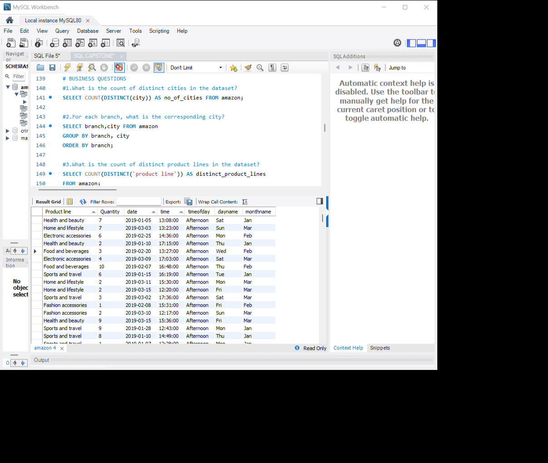
Output :

Slide 11
7. BUSINESS QUESTIONS :
1. Count of distinct cities : 3 (Yangon, Naypyitaw, Mandalay)
2. For each branch, the corresponding city :
A | Yangon
B | Mandalay
C | Naypyitaw
3. Count of distinct product lines : 6
4. Payment method occurs most frequently : Ewallet
5. Product line has the highest sales : Food and beverages (56144.84)
Jan | 116291.86800000005
Feb | 97219.37399999997
Mar | 109455.50700000004
6. Revenue is generated each month :

Slide 12
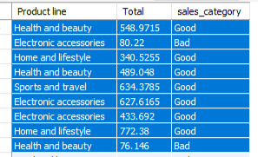
7. Month in which the cost of goods reach its peak: Jan (110754.160)
8. Product line generated the highest revenue : Food and beverages (56144.844)
9. city with highest revenue recorded :
10. product line incurred the highest Value Added Tax? : Food and beverages (2673.563)
11. For each product line, add a column indicating "Good" if its sales are above average, otherwise "Bad.“ :
Naypyitaw (110568.7)

Slide 13
12. Branch that exceeded the average number of products sold : C
13. Product line is most frequently associated with each gender :
14. Average rating for each product line :
Gender | Product line | Count
Male | Health and beauty | 88
Female | Fashion accessories | 96
Product lines | Average ratings
Food and beverages | 7.113218390804598
Fashion accessories | 7.029213483146067
Health and beauty | 7.003289473684212
Electronic accessories | 6.92470588235294
Sports and travel | 6.916265060240964
Home and lifestyle | 6.8375

Slide 14
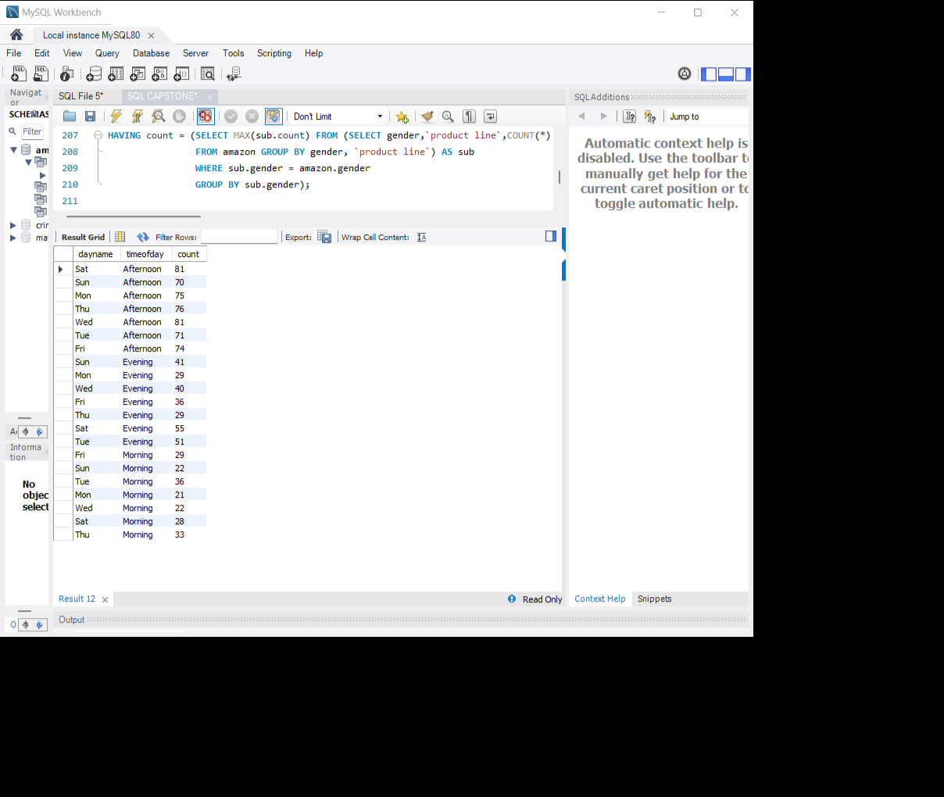
15. Sales occurrences for each time of day on every weekday :
16. Customer type contributing the highest revenue : Member(164223.44)
17. City with the highest VAT percentage : Mandalay (4.761904)
18. Customer type with the highest VAT payments : Member (7820.164)
19. Count of distinct customer types in the dataset : 2

Slide 15
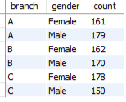
20. Count of distinct payment methods in the dataset : 3
21. Customer type occurs most frequently : Member
22. Customer type with the highest purchase frequency: Member
23. Predominant gender among customers : Female
24. Distribution of genders within each branch :
25. Time of day when customers provide the most ratings : Afternoon(528)

Slide 16
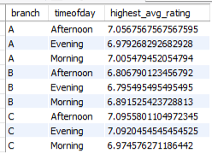
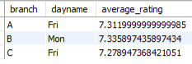
26. Time of day with the highest customer ratings for each branch :
27. Day of the week with the highest average ratings : Monday (7.153)
28. Day of the week with the highest average ratings for each branch :

Slide 17
THANK YOU

